Slide 1
Indigenous Peoples, HIV and Suicide: Opportunities through UHC
AIDS 2018 Satellite: High Rates of Suicide Among People Living With HIV: Implications for the Health and Well-being of Indigenous Peoples
Andy Seale
HIV Department and Global Hepatitis Programme
World Health Organization, Geneva
sealean@who.int
25 July 2018

Slide 2
Indigenous Peoples, HIV and Suicide: Opportunities through UHC
Health outcomes related to HIV and suicide
Inequitable access to all health services
Data and evidence
Individual knowledge of health status and risk
Health service access is a key determinant of indigenous peoples’ health and suicide risk
Universal Health Coverage
Notes:
I am starting this presentation with my concluding slide. This is the key message from my intervention today.

Slide 3
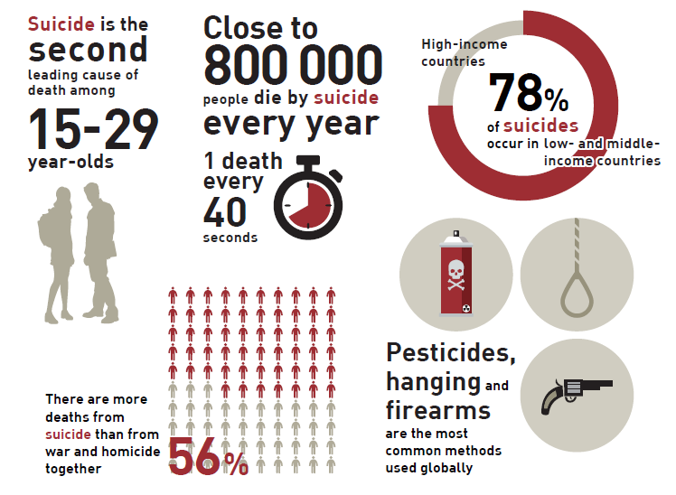
Suicide: global facts and figures
Source: WHO Department of Mental Health and Substance Abuse
Notes:
Let me start with a brief reminder of the global picture. Many of you will be aware of these figures and some have been mentioned by previous speakers today.

Slide 4
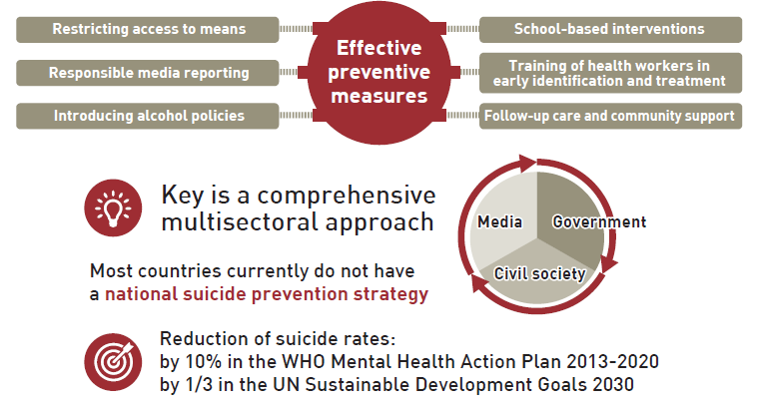
The global picture: suicides are preventable
Source: WHO Department of Mental Health and Substance Abuse
Notes:
While effective prevention measures exist they are currently failing indigenous peoples in many contexts – eitehr because of inefficient scale in through poor programme design

Slide 5
Suicide and HIV
Suicide rates higher among people living with HIV when compared to the general population
similar trends are seen in cancer patients
Suicide rates higher in groups marginalized and discriminated against as well as indigenous peoples groups may also include refugees and migrants; men who have sex with men and other groups marginalised because of sexual orientation and/or gender identity including transgender people; people who use drugs and prisoners
Mental health and HIV – a combined challenge for many individuals and affected communities
Suicide and intersectionality – multiple marginalized identities may increase risk – health service access as a measure of marginalization
Sources: WHO, 2014; Kumar et al, 2017; Croxford et al, 2017; Chandler and Lalonde, 2008
Notes:
Suicide Rates in Cancer Patients in the Current Era in United States
Vivek Kumar, M.D., Neha Chaudhary, M.D., Parita Soni, M.B.B.S., Prameeta Jha, M.B.B.S.
Published Online:26 Jan 2017https://doi.org/10.1176/appi.ajp-rj.2017.120104
Sara Croxford et al (2017) Mortality and causes of death in people diagnosed with HIV in the era of highly active antiretroviral therapy compared with the general population: an analysis of a national observational cohort. The Lancet Public Health. Volume 2, Issue 1, January 2017, Pages e35-e46 https://doi.org/10.1016/S2468-2667(16)30020-2

Slide 6
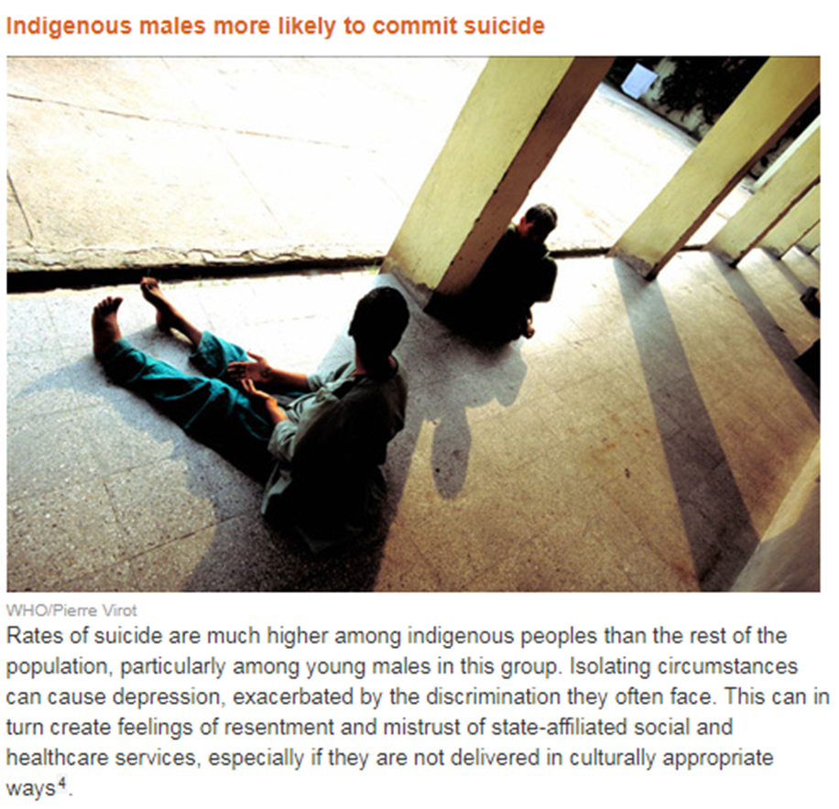
Suicide and indigenous peoples
Insufficient data - consistently higher rates than in non-indigenous communities
Prevalence of suicidal thoughts and attempts may increase with age when compared to non-indigenous communities
Youth suicide rates often highest: 40 times higher reported in Canada, 12 times higher reported in Aboriginal and Torres Strait Islander youth when compared to non-indigenous communities
“Shockingly deficient local health care” a factor in suicide rates six times higher in Canada’s Inuit regions (Webster, 2016)
Interventions applied are often ineffective
Sources: Armstrong et al, 2017; Webster, 2016; Skerret et al, 2017; WHO Website, n/a; WHO Preventing suicide.; 2014
Notes:
Webster, P (2016) Canada’s indigenous suicide crisis. The Lancet, Volume 387 https://doi.org/10.1016/S0140-6736(16)30836-4
Armstrong G, Pirkis J, Arabena K, Currier D, Spittal MJ, Jorm AF. (2017) Suicidal behaviour in Indigenous compared to non-Indigenous males in urban and regional Australia: Prevalence data suggest disparities increase across age groups. Aust N Z J Psychiatry. 2017 Dec;51(12):1240-1248. doi: 10.1177/0004867417704059.

Slide 7
Complexity and suicide
Complexity = no single approach can achieve impact
Suicide recognized as a global public health priority in 2014
Suicide prevention efforts require coordination and collaboration among multiple sectors including: health sector, education, labour, agriculture, business, justice, law, defense, politics and the media
Raising community awareness and breaking down stigma and the taboos that prevent discussion
Culture can contribute to multi-causality but can also protect
the preservation of traditional identities has been established as an important protective factor among First Nations and indigenous communities in North America
Access to all health services critical- suicide risk in cancer patients in Taiwan reduced following the introduction of National Health Insurance in 1995
Sources: WHO Website, n/a; WHO Preventing suicide, 2014; Auger, 2016; Lin et al, 2017
Notes:
WHO recognizes suicide as a public health priority. The first WHO World Suicide Report “Preventing suicide: a global imperative” published in 2014, aims to increase the awareness of the public health significance of suicide and suicide attempts and to make suicide prevention a high priority on the global public health agenda. It also aims to encourage and support countries to develop or strengthen comprehensive suicide prevention strategies in a multisectoral public health approach.
Auger, M (2016) Cultural Continuity as a Determinant of Indigenous Peoples’ Health: A Metasynthesis of Qualitative Research in Canada and the United States. The International Indigenous Policy Journal Volume 7 Issue 4 Social Determinants of Indigenous Well-Being: Building a More Complete Understanding m: http://ir.lib.uwo.ca/iipj/vol7/iss4/3 DOI: 10.18584/iipj.2016.7.4.3
Lin PH, Liao SC, Chen IM, Kuo PH, Shan JC, Lee MB, and Chen WJ (2017) Impact of universal health coverage on suicide risk in newly diagnosed cancer patients: Population-based cohort study from 1985 to 2007 in Taiwan. Psychooncology. 2017 Nov;26(11):1852-1859. doi: 10.1002/pon.4396
National Health Insurance (NHI), launched in 1995 in Taiwan, lightens patient's financial burdens but its effect on the suicide risk in cancer patients is unclear. We aimed to investigate the impacts of the NHI on the suicide in newly diagnosed cancer patients.
Methods
We identified patients with newly diagnosed cancer from the nationwide Taiwan Cancer Registration from 1985 to 2007, and ascertained suicide deaths from the national database of registered deaths between 1985 and 2009. Standardized mortality ratio (SMR) of suicide risk among patients with cancer was calculated, and the suicide risk ratios were examined by gender, age group, and prognosis.
Results
For the 916 337 registered cancer patients with 4 300 953 person‐years, 2 543 died by suicide, with a suicide rate of 59.1 per 100 000 person‐years. Compared to the general population, cancer patients had an SMR of 2.47 for suicide, with a higher figure for males (2.73), age 45 to 64 (2.89), and cancer of poor prognosis (3.19). The suicide risk was highest in the first 2 years after the initial diagnosis. Comparing the cohorts of the period before (1985 to 1992) and after (1996 to 2007) the launch of NHI, we saw a reduction in the SMR within the first 2 years after cancer diagnosis (20%), with more prominent reduction for females (29%), age under 45 (69%), and cancer of good prognosis (33%).
Conclusions
A universal health coverage relieving both physical and psychological distress may account for the post‐NHI reduction of immediate suicide risk in patients of newly diagnosed cancer.

Slide 8
UHC – a people-centered approach
A political opportunity to revolutionize health in broad terms
WHO call to action launched at the UNGA 2017
Leave no-one behind - health as a human right
Considerable momentum across sectors
Domestic resource mobilization for health to nationally identified health service package
Source: WHO (2017). Together on the Road to Universal Health Coverage: A Call to Action.
Available at: http://apps.who.int/iris/bitstream/10665/258962/1/WHO-HIS-HGF-17.1-eng.pdf?ua=1
Notes:
UHC is a people-centered approach. A call to action was launched by WHO at the UNGA in 2017 and the momentum is picking up strongly globallay and in countries and communities ... and while the focus is on health, it will require cross-sectoral momentum to be successful, with the health sector sector being the major driver. A central paradigm in this discussion is to leave one behind. This is also an oppportunity to increase domestic resource for health to allocate pooled fund to nationally identified health service package.

Slide 9
Three dimensions of universal health coverage
^{Leave no-one behind}
- Services for inclusion in essential UHC packages
- Populations and locations requiring focus for equity
^{- Finance and cost}
Notes:
At the heart of UHC is that all people receive the services they need of sufficient quality without incurring financial hardship. There are three dimensions to this. First it is about financing and costs. This includes issues like how much is covered, how many resources are made available, and how costs are being shared. The second dimension is which services are being included and offered in the UHC packages. And thirdly, it is about populations and locations: who requires special focus and where are extra efforts needed to reach? In essence this is very much what the HIV movement over the last 30 has been struggling with, and continues to aspire to address.

Slide 10
Comprehensive intervention package for key populations – what is the package for indigenous peoples?
Condom programming
Harm reduction interventions (needle and syringe programmes, opioid substitution therapy and community distribution of naloxone)
Behavioural interventions
HIV testing and treatment - ART
ART related prevention: PrEP and PEP
Prevention and management of viral hepatitis, tuberculosis and mental health conditions
Sexual and reproductive health interventions
Supportive legislation, policy and funding
Addressing stigma and discrimination
Community empowerment
Addressing violence
Health interventions
Structural interventions part of a comprehensive public health approach
Structural
interventions
Source: WHO, Consolidated guidelines on HIV prevention, diagnosis, treatment and care for key populations 2016
Notes:
A proposed intervention package to secure HIV impact among key populations has been put forward by WHO to include the various health interventions of proven effectiveness: it includes prevention interventions, testing and treatment for HIV, but also other comorbidities, and related services such as mental health services and includes structural interventions to address supportive legislations, policy and funding, stigma, and violence – all these require cross sector collaboration. This approach could effectively be adapted or a similar approach developed for indigenous peoples.

Slide 11
Making UHC work to address HIV and suicide in indigenous peoples
Focus on engagement and intersectionalities
Bring known effective interventions have to scale
Targeted people-centered services – combine high impact HIV interventions with other essential interventions including mental health
Include structural and behavioral interventions alongside health and clinical interventions
Advocate for increased health budgets and funding for comprehensive health services for indigenous peoples and a defined UHC package
Invest in frontline health workers and community services to increase service reach and acceptability and address stigma – including through recruitment and training of staff from communities of indigenous peoples
Build a partnership approach

Slide 12
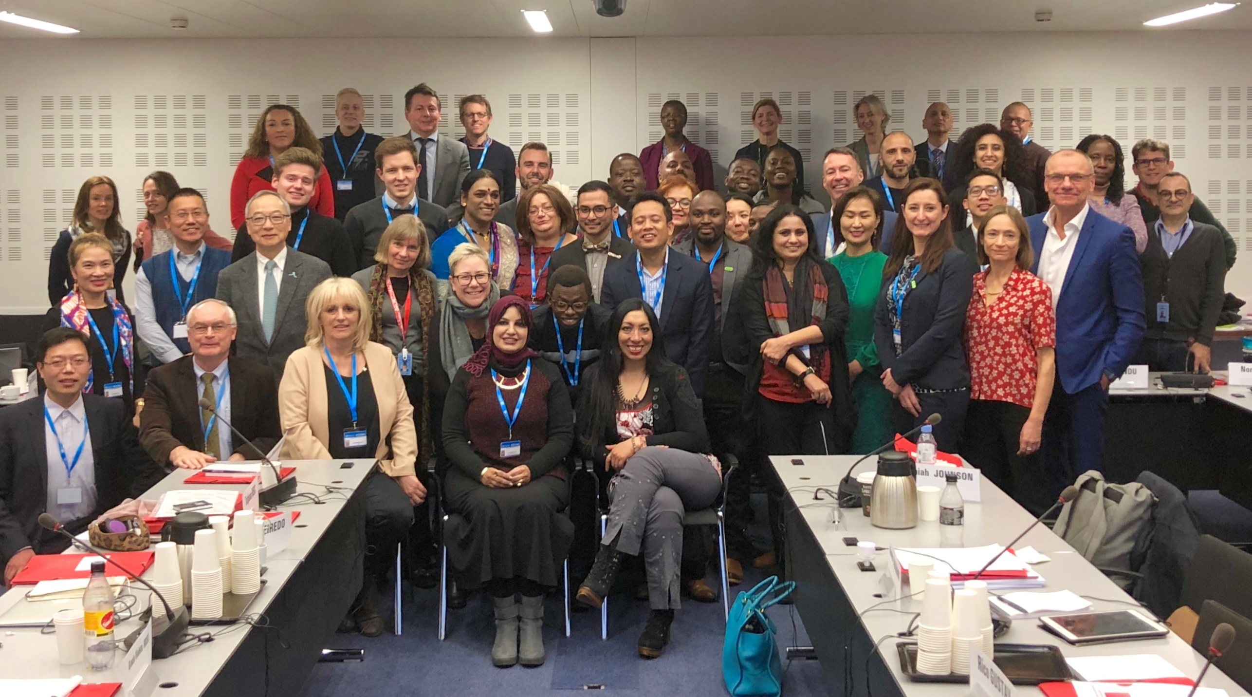
Indigenous peoples’ perspectives – informing UHC thinking at WHO and global policy discussion
The 2017 UN General Assembly adopted a resolution calling for all people to have equal access to health services, and agreeing to hold a high-level meeting on universal health coverage in 2019
The suicide mortality rate is an indicator of target 3.4 of the Sustainable Development Goals: by 2030, to reduce by one third premature mortality from noncommunicable diseases through prevention and treatment, and promote mental health and well-being
http://www.who.int/hiv/pub/meetingreports/uhc-cso-meeting/en/
Notes:
Note the incraesed visibility of indigenous peoples in global health forums including the PCB
Reference the presence in the March meeting of two other panellists (Erika and Marama) and the contributions to the conclusions:
Universal health coverage and communicable diseases is not an “either/or” agenda and universal health coverage does not mean the end of vertical programming but will require a rethinking of how disease programmes are delivered;
Universal health coverage requires close collaboration to rethink how disease programmes are designed and delivered in the future;
Strong recommendations were made for strengthening essential intervention packages, stronger community services and ideas to increase access to affordable and essential medicines and commodities including through the notion of “entry point” packages for different populations;
Structural interventions should be included in the essential package – including a commitment to tackling punitive laws that exclude affected populations;
Community services should be costed and work at community level should be adequately remunerated;
Clearer definitions are required including for “health system” and what it includes;
At country level, there may be incentives for marginalized groups to collaborate to influence essential health benefit packages – rather than doing this through an individual issue or population focus.
WHO will seek to continue to leverage its high-level advocacy to drive down commodity prices – applying aspects of comprehensive price reduction strategies including those that encourage local production of key medicines and commodities;
WHO will strongly support the development of investment case approaches;
WHO and stakeholders should invest in “systems literacy” that encourages affected communities and civil society groups to understand and appreciate opportunities to advocate for sustainable and effective health systems;
WHO and civil society should seize universal health coverage as an opportunity to build unprecedented political momentum based on a strong sense of injustice – Leave No One Behind;
The political dimension of universal health coverage was emphasized and such political considerations should be grounded in a human-rights framework;
WHO will continue to pursue appropriate data disaggregation in monitoring progress in health responses, including through the identification of indicators that enables accountability for all populations - a single indicator to track marginalized and overlooked populations is recommended;
The possible broader application of an approach similar to that of the national composite policy index in HIV will be explored;

Slide 13
Conclusions
Health outcomes related to HIV and suicide
Inequitable access to all health services
Data and evidence
Individual knowledge of health status and risk
Notes:
I am starting this presentation with my concluding slide. This is the key message from my intervention today.

Slide 14
References and Acknowledgments
References
Armstrong G, Pirkis J, Arabena K, Currier D, Spittal MJ, Jorm AF. (2017) Suicidal behaviour in Indigenous compared to non-Indigenous males in urban and regional Australia: Prevalence data suggest disparities increase across age groups. Aust N Z J Psychiatry. 2017 Dec;51(12):1240-1248. doi: 10.1177/0004867417704059.
Auger, M (2016) Cultural Continuity as a Determinant of Indigenous Peoples’ Health: A Metasynthesis of Qualitative Research in Canada and the United States. The International Indigenous Policy Journal Volume 7 Issue 4 Social Determinants of Indigenous Well-Being: Building a More Complete Understanding m: http://ir.lib.uwo.ca/iipj/vol7/iss4/3 DOI: 10.18584/iipj.2016.7.4.3
Chandler, J, Lalonde, M (2008) Cultural Continuity as a Protective Factor Against Suicide in First Nations Youth. Horizons. 10.
Kumar, V, Chaudhary, N, Soni, P, Jha, P (2017) Suicide Rates in Cancer Patients in the Current Era in United States doi.org/10.1176/appi.ajp-rj.2017.120104
Lin PH, Liao SC, Chen IM, Kuo PH, Shan JC, Lee MB, and Chen WJ (2017) Impact of universal health coverage on suicide risk in newly diagnosed cancer patients: Population-based cohort study from 1985 to 2007 in Taiwan. Psychooncology. 2017 Nov;26(11):1852-1859. doi: 10.1002/pon.4396
Croxford, S et al (2017) Mortality and causes of death in people diagnosed with HIV in the era of highly active antiretroviral therapy compared with the general population: an analysis of a national observational cohort. The Lancet Public Health. Volume 2, Issue 1, January 2017, Pages e35-e46 https://doi.org/10.1016/S2468-2667(16)30020-2
Webster, P (2016) Canada’s indigenous suicide crisis. The Lancet, Volume 387 https://doi.org/10.1016/S0140-6736(16)30836-4
WHO (2014) Preventing suicide http://www.who.int/mental_health/suicide-prevention/world_report_2014/en/
WHO (2017). Together on the Road to Universal Health Coverage: A Call to Action. Available at: http://apps.who.int/iris/bitstream/10665/258962/1/WHO-HIS-HGF-17.1-eng.pdf?ua=1
Acknowledgments
Giovanni Ravassi, Pan American Health Organization
Andrew Ball, Department of HIV and Global Hepatitis Programme
Akihito Watabe, UHC2030 Core Team, Department of Health Systems Governance and Financing
Rachel Baggaley, Department of HIV and Global Hepatitis Programme
Alexandra Fleischmann, Department of Mental Health and Substance Abuse

